Slide 1
Data Mining Project Report
E-Commerce Dataset
Presented by -
Akshita Gupta (0854)
Akanksha Goel (0726)
Deepti Meena (0809)
Garima Pandey (0730)

Slide 2
Overview
The Dataset titled E-Commerce Data has originally been taken from Kaggle. The dataset informs us about the daily Sale and Purchase of All-Occasion Gifts in the Year 2020-21.
The dataset sheds light onto the different types of people that people bought, the purchases they made, and what country they belonged to. This dataset helps us understand which items could be grouped together by the store managers so that there could be an upscale of purchasing of these items.

Slide 3
Problem Insights
541909 Rows
8 Columns
Given a transactional dataset of an All-Occasion Gift Store, apply the best suitable algorithm for association analysis in order to find the most related items together.
Python
Numpy
Pandas
Matplotlib
Seaborn
Apriori
Association Rules
Networkx
Rows and Columns
Problem Statement
Language and Libraries
01
02
03

Slide 4
Process Flow for Data Mining
01
Step-2
03
Step-4
05
Making a new dataframe from those columns
Applying Apriori
Step-1
02
Step-3
04
Step-5
Taking into account the columns to be analyzed
Performing Basic Analysis
Concluding the Analysis

Slide 5
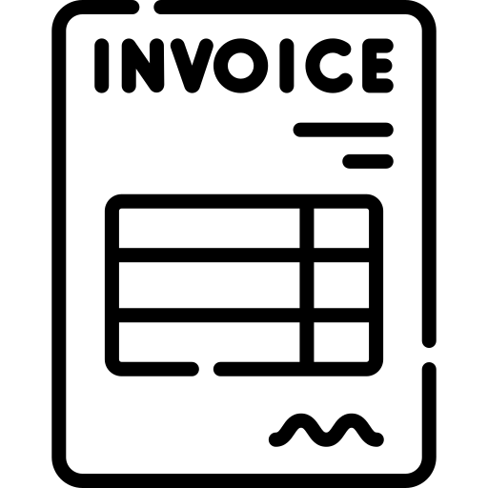


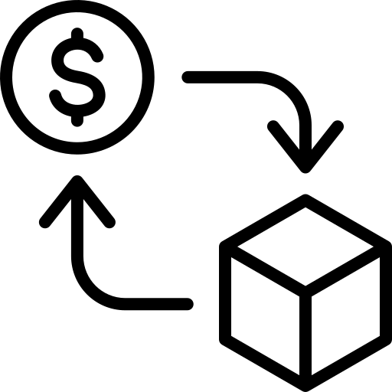

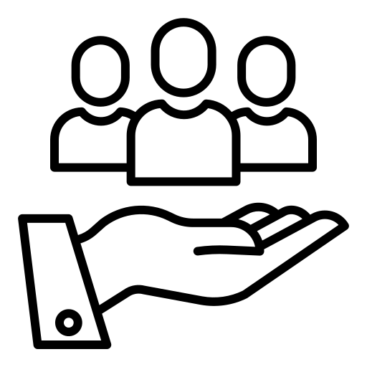


Glance at the Columns
InvoiceNo
InvoiceDate
Invoice Number of the Product
Date & Time of Purchase
StockCode
UnitPrice
Code of that particular product
Product price per unit
Description
CustomerId
Detail of the product
Id of customer
Quantity
Country
Number of product counts
Order made in different countries

Slide 6
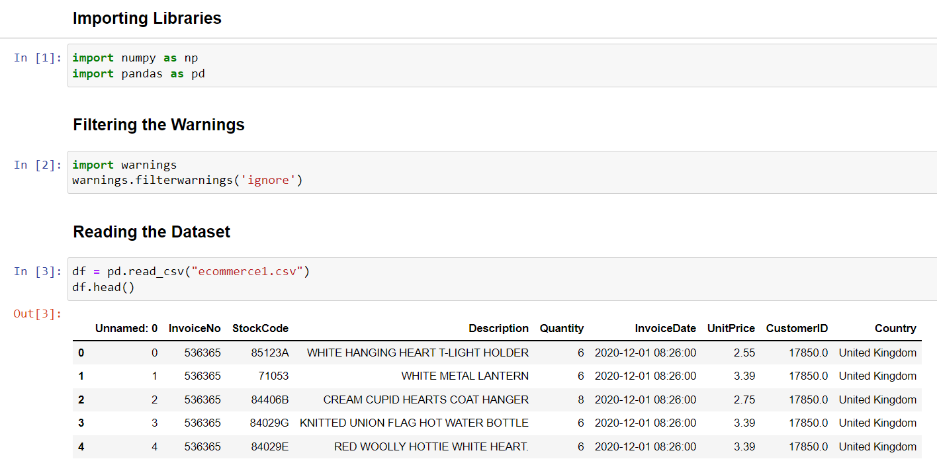
Initial Steps

Slide 7
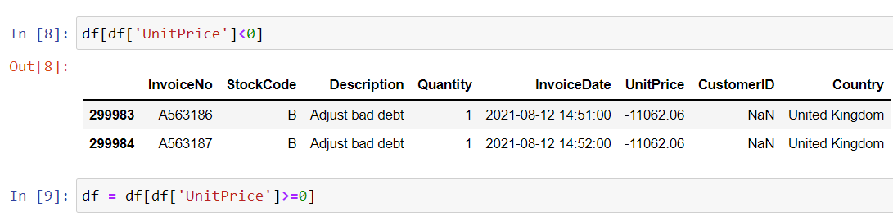
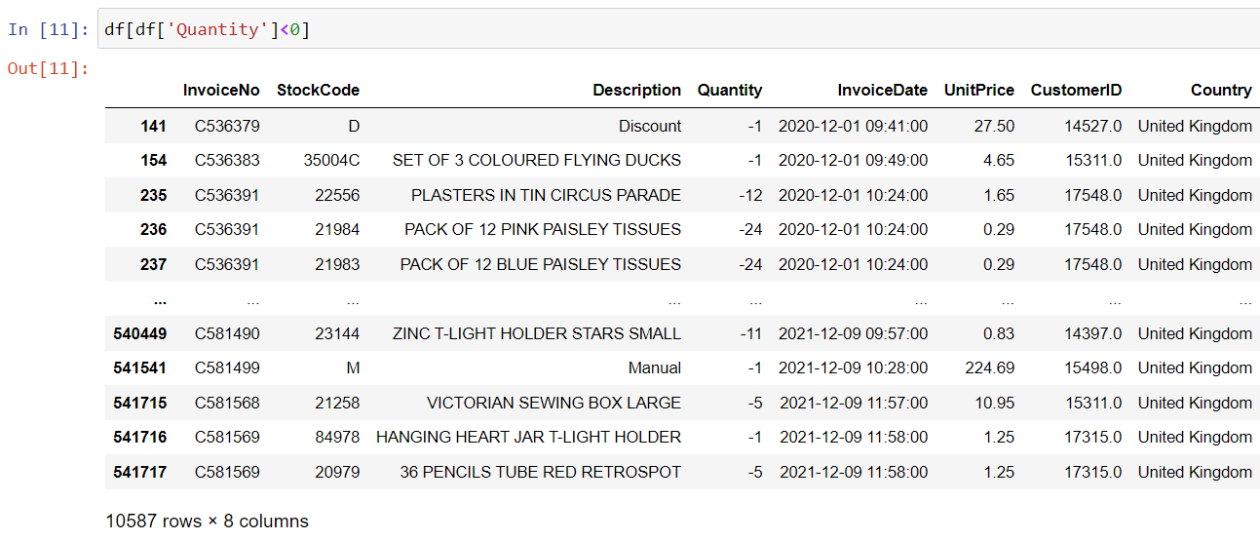
Cleaning

Slide 8
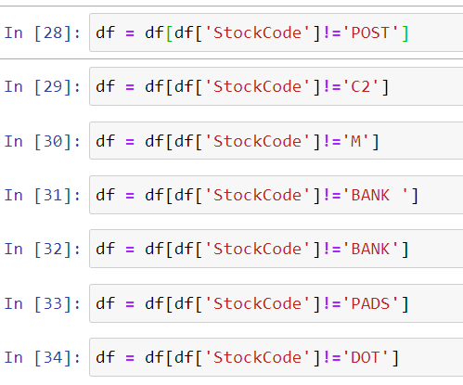
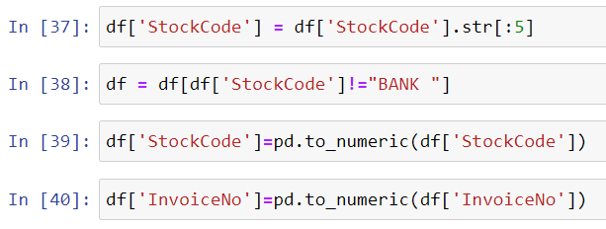
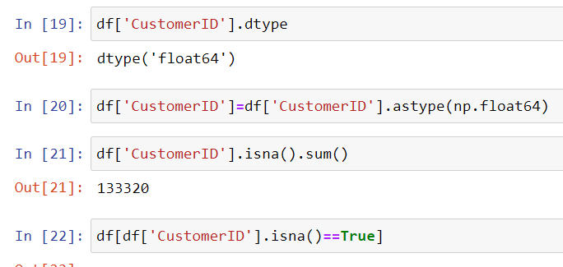
StockCode and Invoice Cleaning and Conversion
CustomerID cleaning

Slide 9
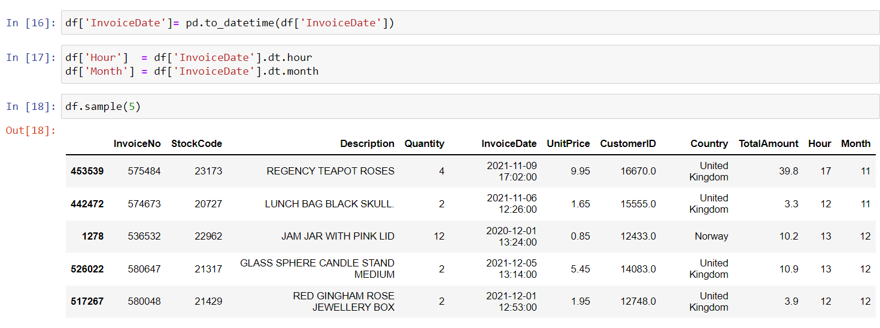
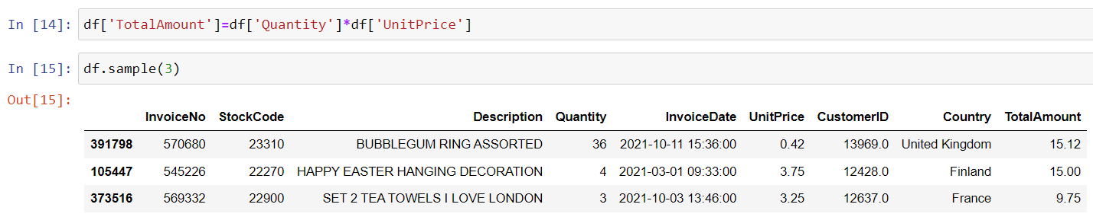
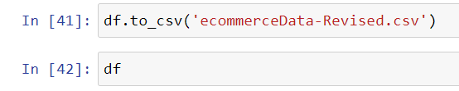
InvoiceDate to DateTime Format and Adding New Columns
Adding TotalAmount
And making new Dataset

Slide 10
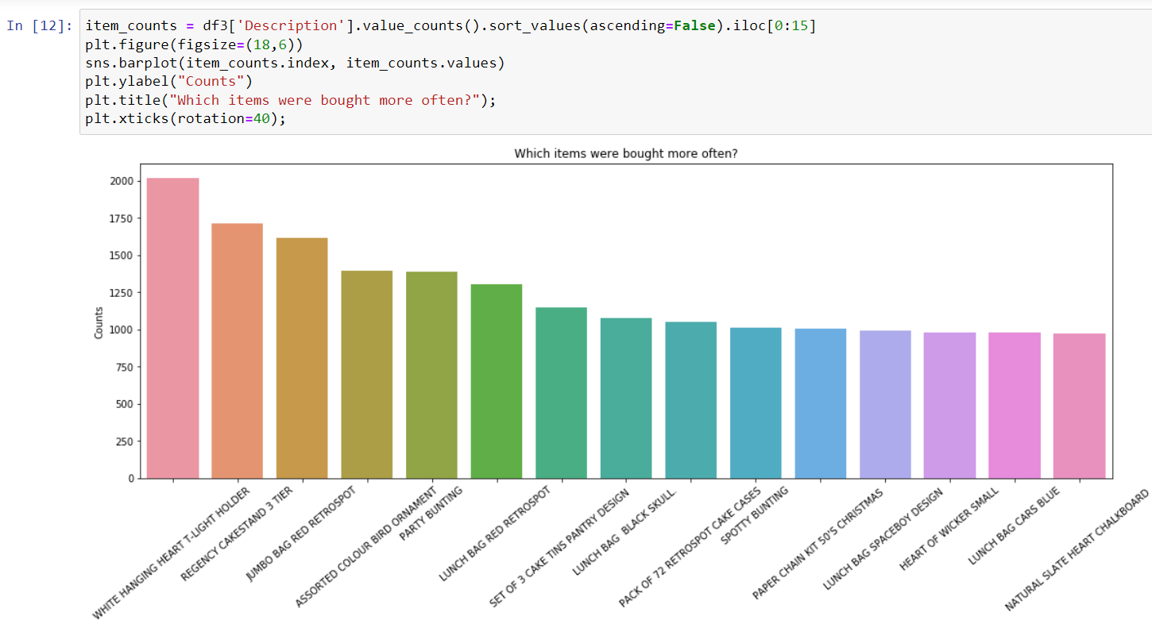
Popular Items Bought

Slide 11
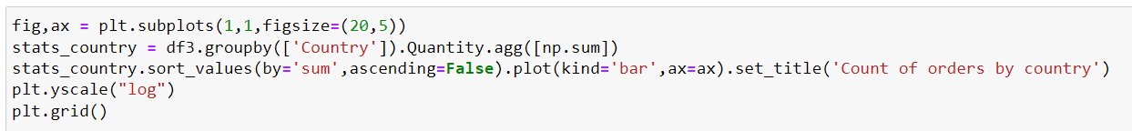
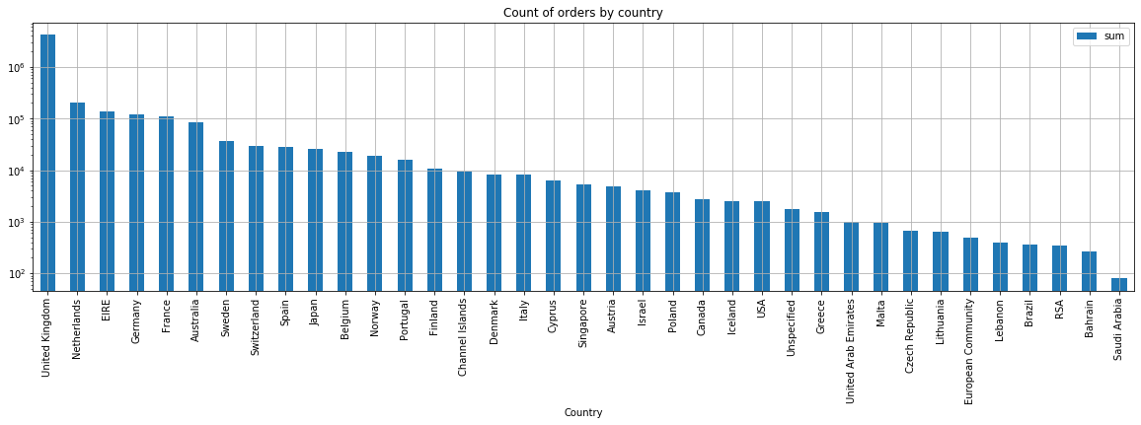
Country Wise Orders

Slide 12
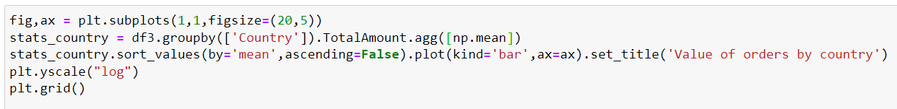
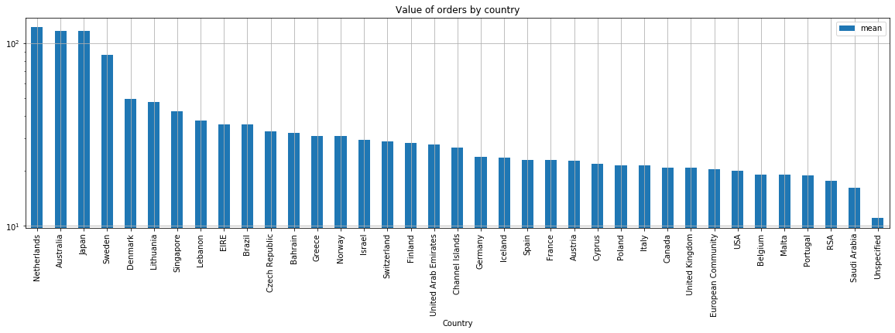
Mean Value of Orders

Slide 13
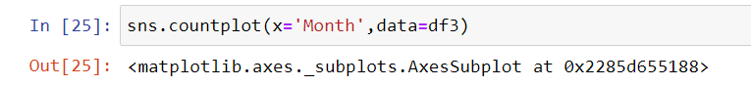
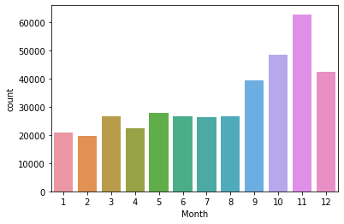
Month Wise Most Orders Placed

Slide 14
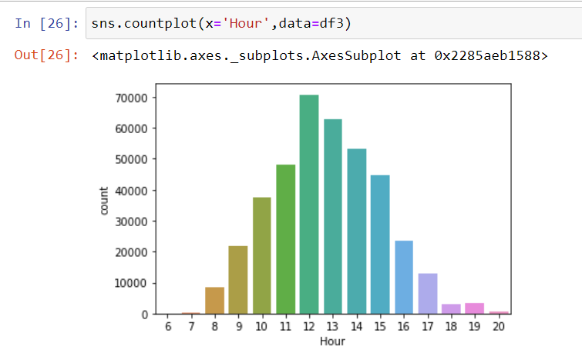
Hour Wise Most Orders Placed

Slide 15
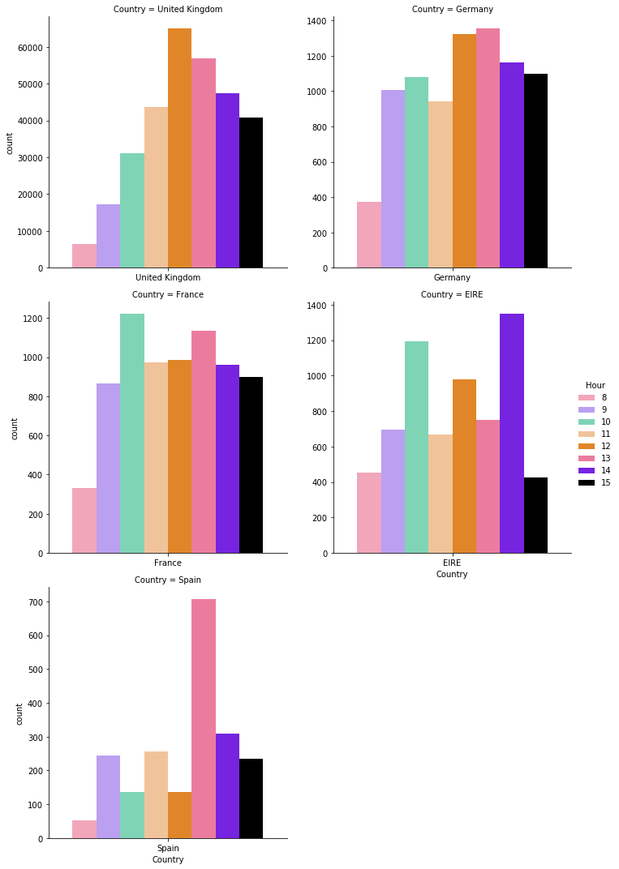
Country Wise Peak Shopping Hours

Slide 16

Market-Basket Analysis

Slide 17
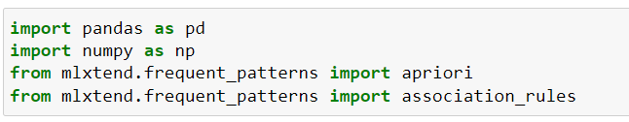
Apriori Principle
Importing essential libraries
All subsets of a frequent itemset must be frequent(Apriori Property).
Conversely, If an itemset is infrequent, all its supersets will be infrequent.

Slide 18
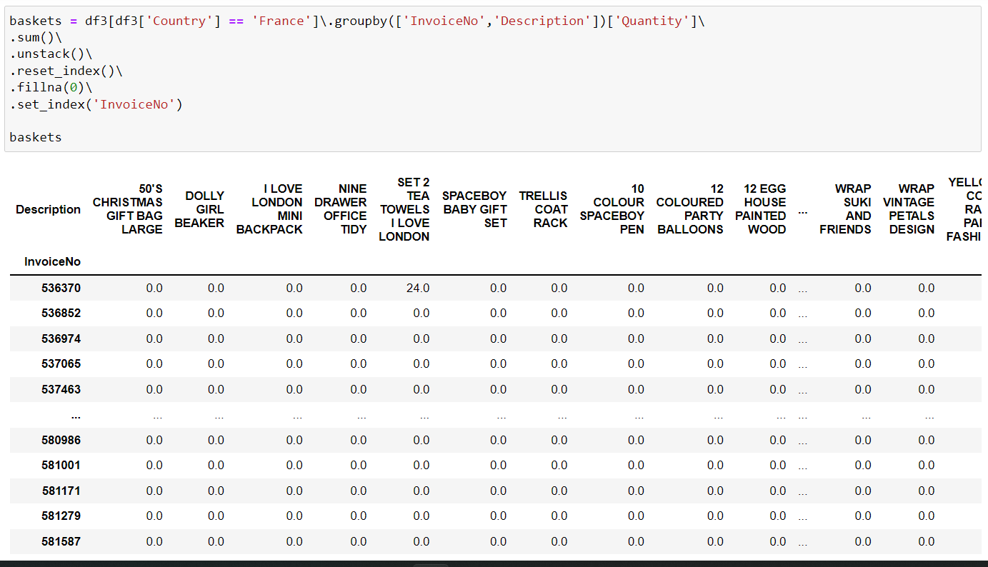

Slide 19
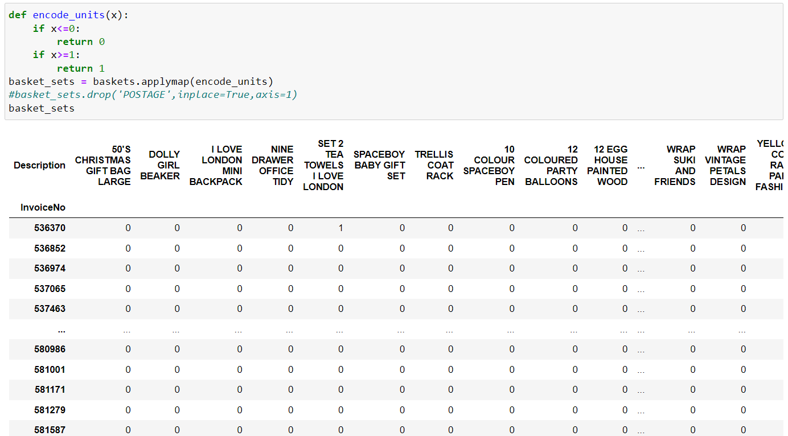

Slide 20
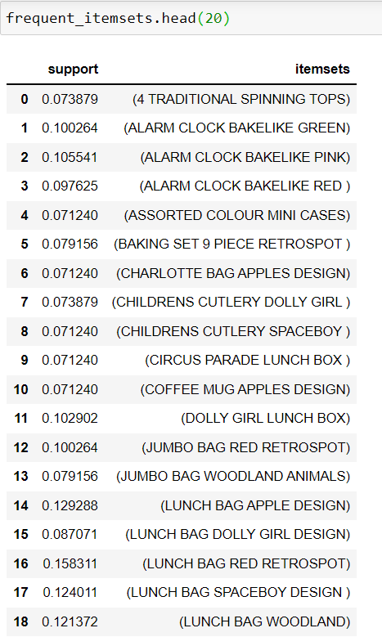
Frequent Itemsets generated

Slide 21
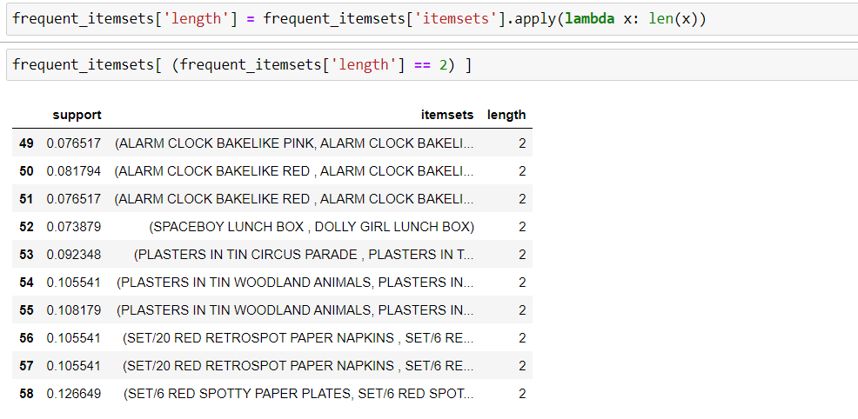
FREQUENT - 2 ITEMSETS

Slide 22
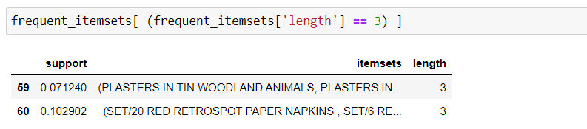
FREQUENT - 3 ITEMSETS

Slide 23
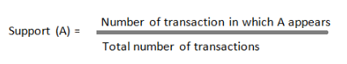
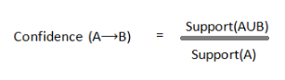
GENERATING ASSOCIATION RULES
Indicates how frequently an itemset appears in the database.
SUPPORT
Checks the reliability of the inference rule made.
Support (X and Y) / Support (X). Indicates how often this rule has been found in the database
CONFIDENCE

Slide 24
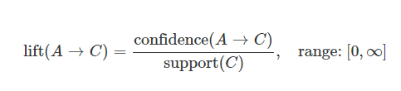
LIFT
Lift indicates the strength of an association rule over the random co-occurrence of item A and item B.
CONVICTION
A high conviction value means that the consequent is highly depending on the antecedent.
Leverage computes the difference between the observed frequency of A and C appearing together and the frequency that would be expected if A and C were independent. A leverage value of 0 indicates independence.
LEVERAGE

Slide 25
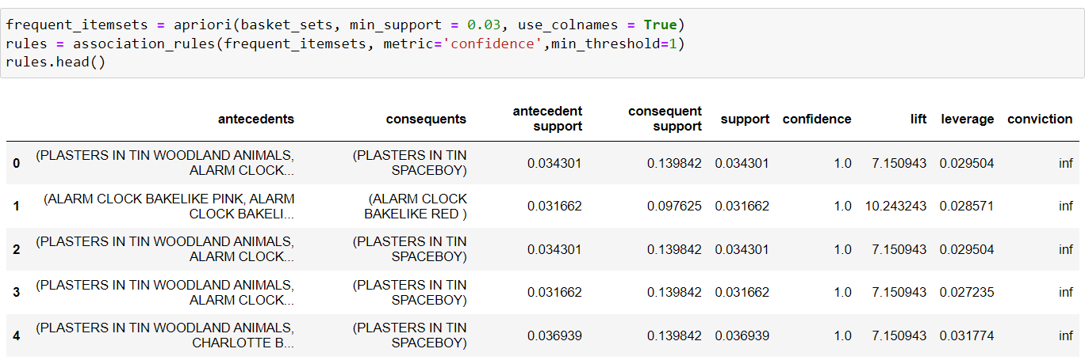
Association Rules
Not very interesting insights when we take ‘confidence’ as out metric.Thus, we take ‘lift’ as the right metric.

Slide 26
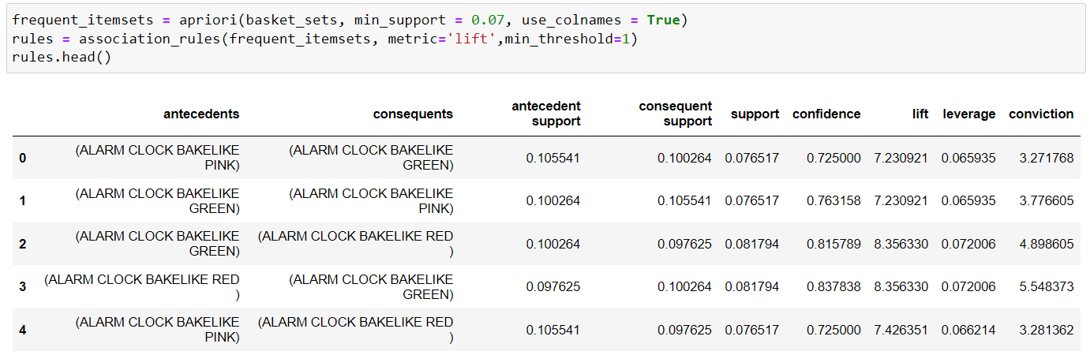
Lift as the metric

Slide 27
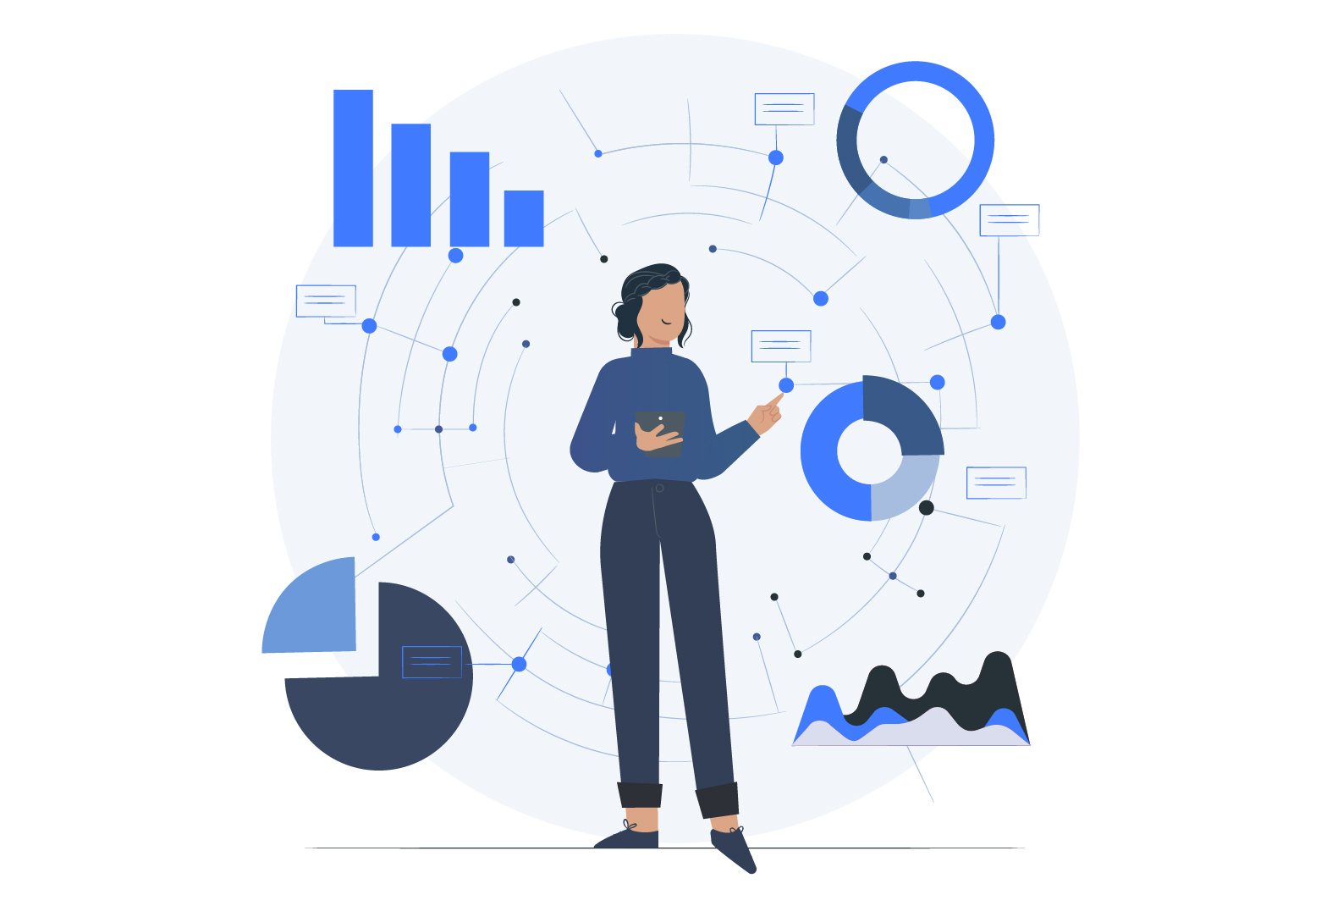
VISUALISATION OF MARKET BASKET ANALYSIS

Slide 28
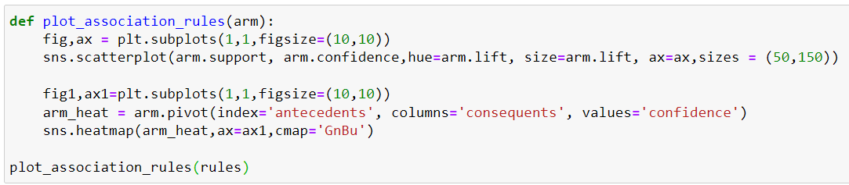

Slide 29
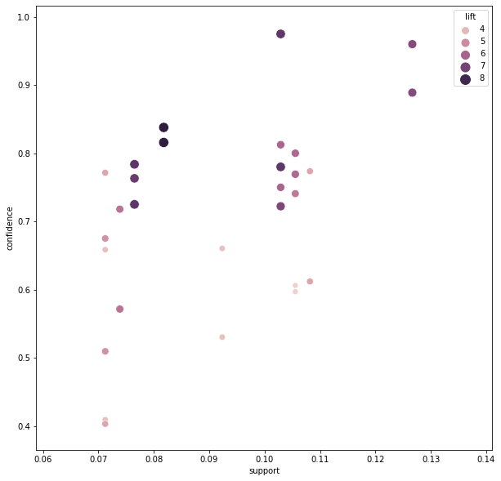

Slide 30
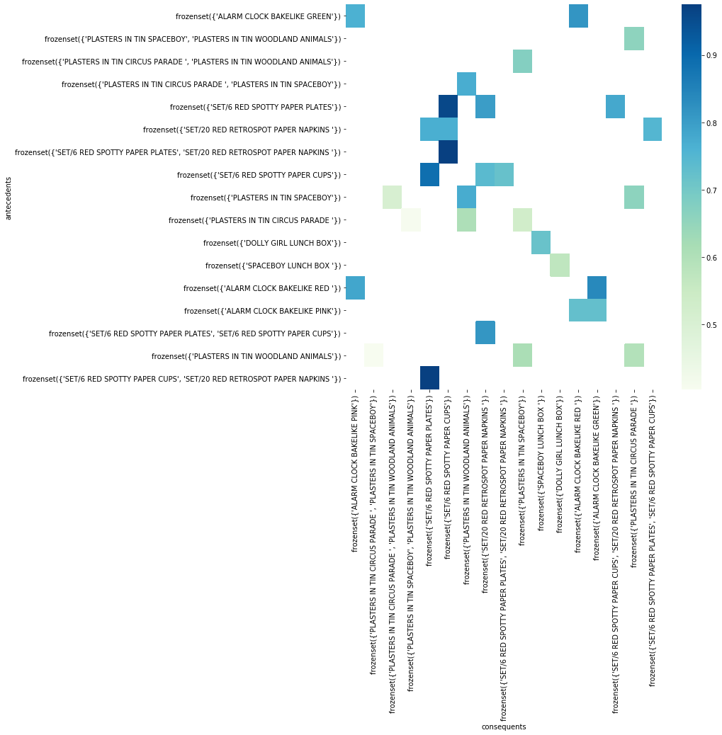

Slide 31
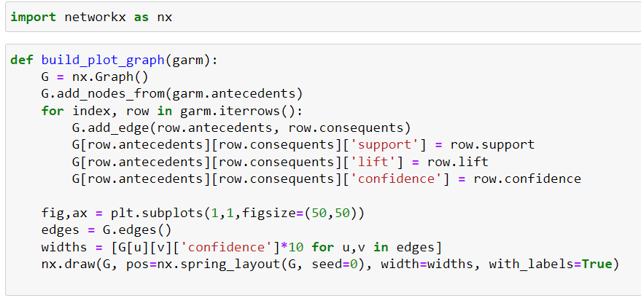

Slide 32
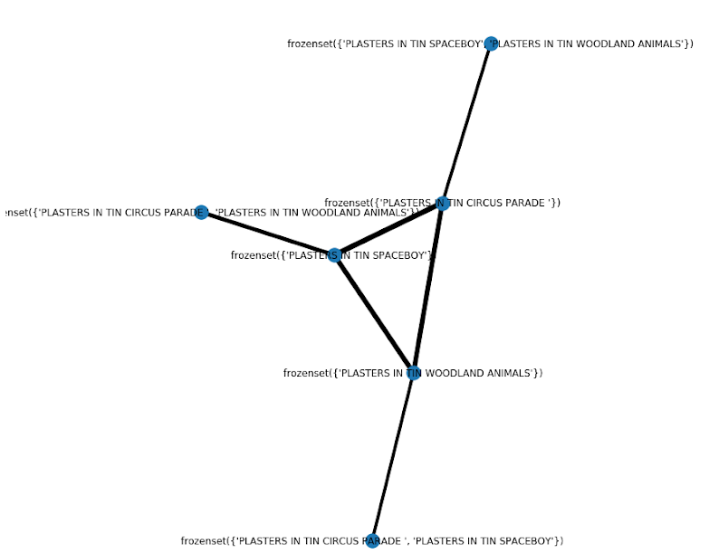

Slide 34
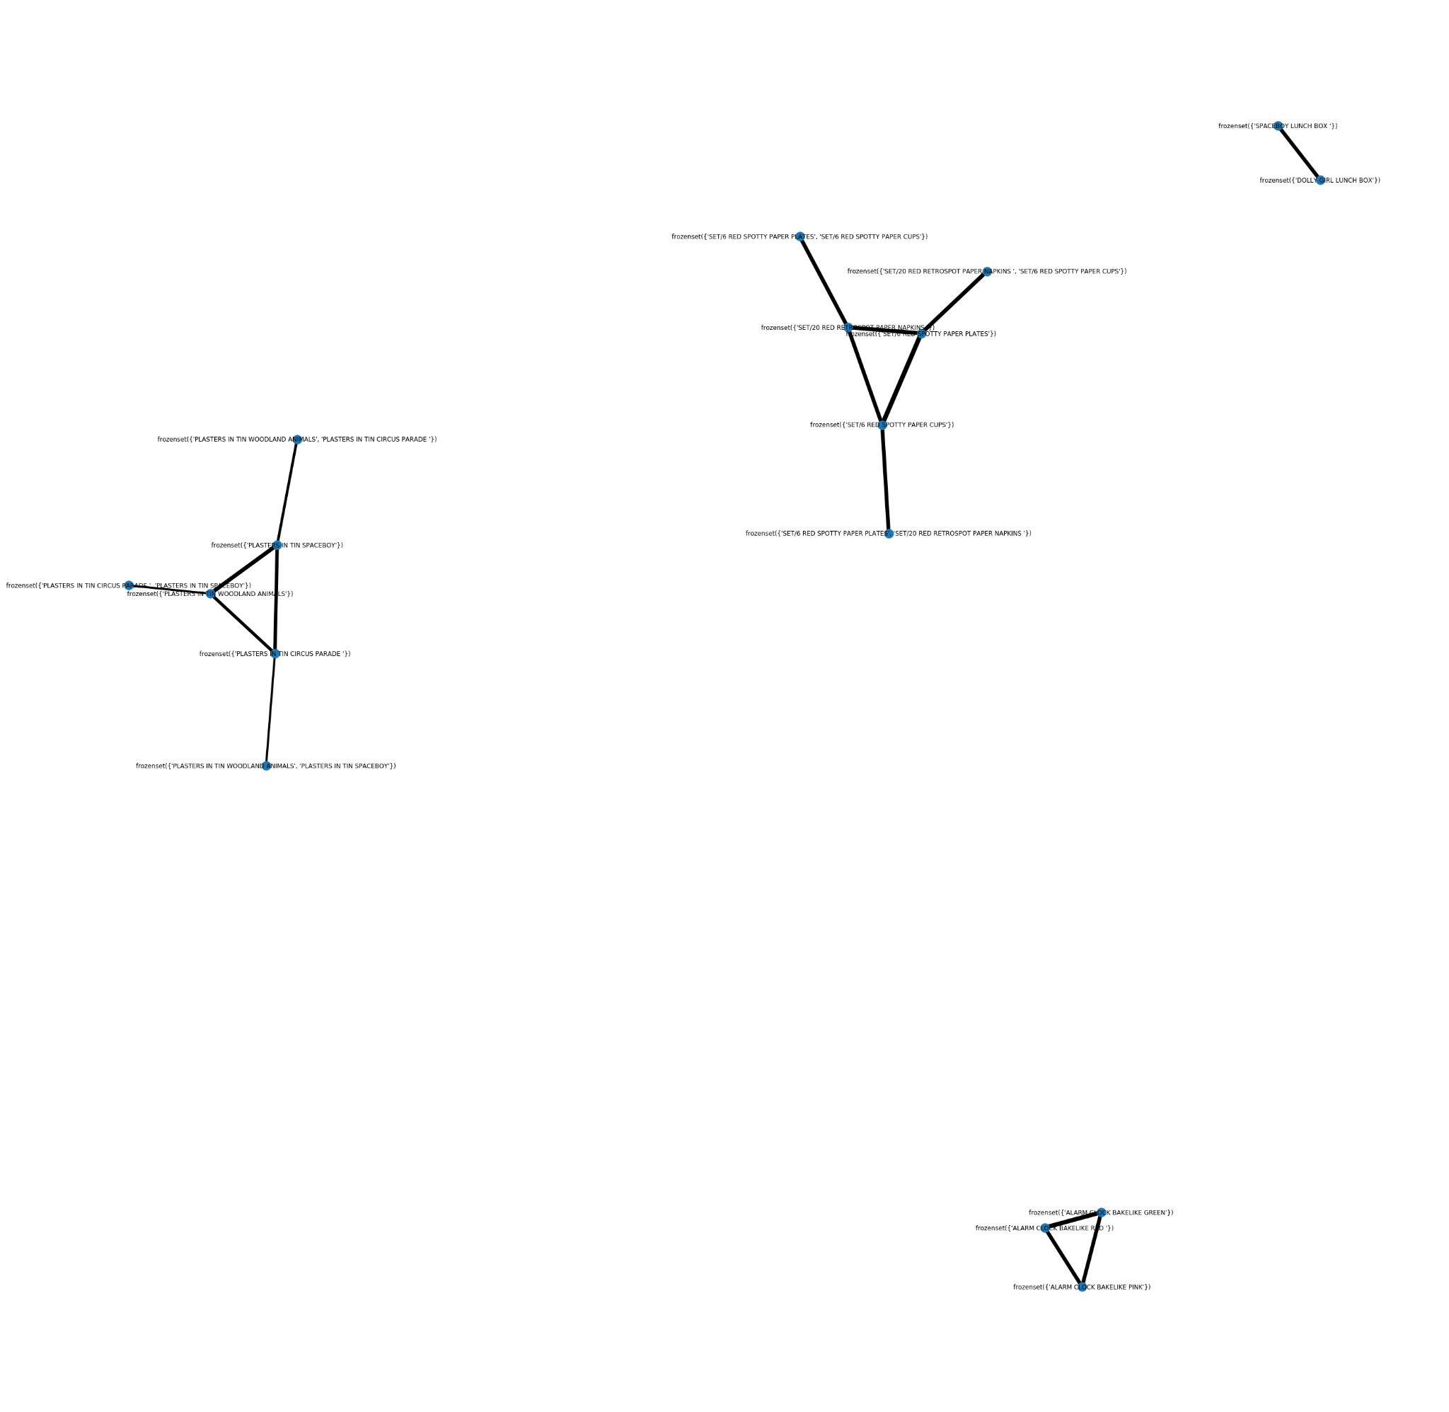

Slide 35
Conclusions
White Hanging Light Holder is the most shopped product in the store.
The store got the maximum orders from UK. We can conclude that given the charts, the store was situated in UK.
The store saw a surge in the number of customers in the month of November.
Most of the expensive products were bought by the people of Netherlands.
11 AM to 3 PM were the peak hours where customers preferred shopping.

Slide 36
Conclusions by Apriori
Paper Cups and Paper Plates followed by Paper Cups and Paper Napkins were frequently bought together.
Optimal Rules are the ones that lie on the Support or Confidence Boundary and are maximized.
Maximum Frequent-3 itemsets were generated in the association analysis.

Slide 37
THANK YOU !
THANK YOU !

